Slide 1


PixelPArlance: Mitigating Hallucination in Automatic Image Captioning
Group members:
Mohammed Shurrab (40323793)
Patrick Liam O'Connor (40310129)
Shariq Anwar (40321507)
Dan Munteanu (40351135)
COMP 6321

Slide 2
Introduction
Modern digital life produces an overwhelming volume of visual content.
Automatic captioning technologies provide more global access to information for people. They can be used to:
Caption videos and convert them to different languages
Analyze images and generate captions which describe the image (accessibility)
Caption an image or video to classify it using the generated caption
Automated captioning’s demand has increased greatly with recent advancements in Machine Learning (ML) algorithms and Artificial Intelligence (AI).
Notes:
Automatic captioning technology has advance quite a bit with ML and AI model improvements. This captioning technology can be used to caption videos from one language and convert them into different languages, analyze images and generate captions which describe the image, caption an image or video to classify it using the generated cation, and much more.

Slide 3
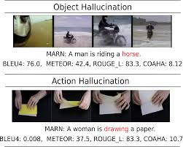
Problem
Machine learning (ML) models, like convolutional neural networks (CNN), and long short-term memory (LSTM), frequently hallucinate details.
Hallucination causes misclassifications of the images leading to details in the images being missed, ignored, or fictional details being added to the caption.
Hallucination erodes user trust in the system.
Notes:
The problem with these models is a common one within ML, hallucination. Hallucination can cause a misclassification of details within the image, details being added to the caption which aren’t present in the image, or somethings within the image completely being ignored.
This in turn causes users of the system to lose trust and not believe in the system.

Slide 4
Objective
PixelParlance is a grounded image captioning built on a modern Vision Transformer (ViT) encoder.
PixelParalance’s goal is to generate a single, readable caption for each image along with an implicit grounding signal. It achieves this by:
Training and evaluating from MS COCO 2017 dataset
Incorporating a CLIP-based similarity loss to discourage hallucination
Rigorously evaluating and combining fluency metrics with faithfulness metrics
Analyzing hallucination behaviour by quantifying consistency
Benchmarking against strong baselines
Notes:
The main objective is to develop a grounded image captioning model so that we don't just generate natural language but ensure that it matches the content of the image.

Slide 5
Literature Review
Classic encoder-decoder captioning: Show and Tell, by Vinyals et al.
Vision Transformer (ViT) by Dosovitskiy et al.
Hallucination failure characterized through CHAIR (Caption Hallucination Assessment with Image Relevance) by Rohrbach et al.
CLIP (Constrastive Language-Image Pretraining), CLIPScore, by Hessel et al.
Notes:
Show and Tell was developed by Vinvals et al., and uses a Convolutional Neural Network to encode an image into a global feature vector that conditions an LSTM decoder to predict captions sequentially.
Vision Transformers where introduced by Dosovitsky et al. as an attention-only alternative to CNNs for image encoding.
To formalize the failure of captioning neural models Rohrbach et al. created CHAIR (caption hallucination assessment with image relevance), a metric for assessing hallucination at adaption and instance levels.
Hassel et al. introduce CLIPScore which correlates well with human judgements of semantic alignment and can outperform traditional reference-based evaluations.

Slide 6
Methodology- Data Preprocessing
Data and preprocessing
MS COCO 2017 Captions: 118,287 training images and 5,000 validation images
Integrity checks: 1) image count, 2) open random samples, and 3) inspecting annotation
Caption preprocessing: 1) UTF-8 encoding, 2) remove unprintable characters, and 3) discard empty captions (rare)
Tokenize text using byte-pair encoding (BPE) vocabulary
Pad/truncate text to a length of 30 tokens with attention masks
Notes:
For data and preprocessing we used the publicly available MS COCO 2017 captions corpus for training and evaluation. It contains 118,287 training images and 5000 validation images each paired with five human-written captions. Images are preprocessed using standard transforms for Transformer-based encoders, including resize, tensor conversion, and ImageNet normalization.
Our model architecture follows a Transformer-Transformer design optimized for image captioning.

Slide 7
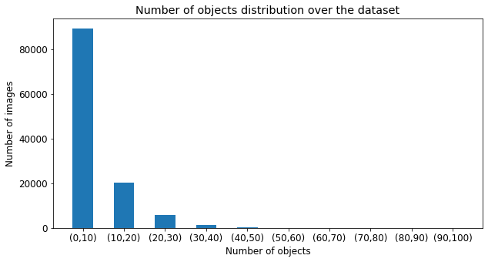
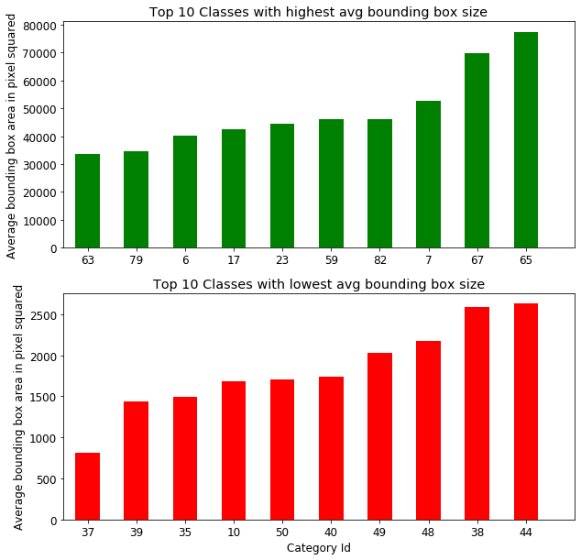
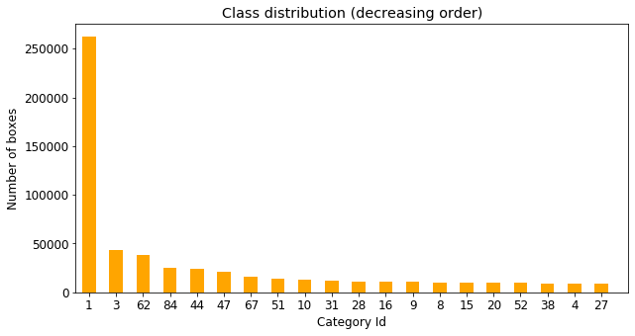
Methodology- EDA
Notes:
120k images, 860k annotated boxes, and 80 categories. Bounding boxes are basically the objects present in an image, where the average is 7. we can see that the majority of images contain less than 10 objects.

Slide 8
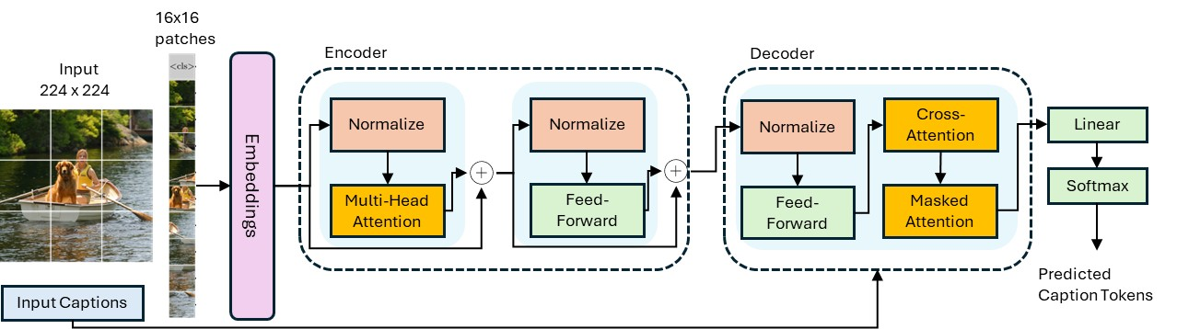
Methodology- Proposed Architecture
We employ ViT-Causal Transformer encoder-decoder architecture.
Resize images (224x224) → 16x16 patches
ViT-B/16 with 12 transformer layers and attention heads (pretrained on ImageNet-1k)
Notes:
For data and preprocessing we used the publicly available MS COCO 2017 captions corpus for training and evaluation. It contains 118,287 training images and 5000 validation images each paired with five human-written captions. Images are preprocessed using standard transforms for Transformer-based encoders, including resize, tensor conversion, and ImageNet normalization.
Our model architecture follows a Transformer-Transformer design optimized for image captioning.

Slide 9
Methodology- Proposed Architecture
Decoder is a causal 6-layer Transformer
Masked self-attention ensures that the transformer can only access past tokens
Cross-attention allows the caption generator to attend to relevant visual patches
Notes:
For data and preprocessing we used the publicly available MS COCO 2017 captions corpus for training and evaluation. It contains 118,287 training images and 5000 validation images each paired with five human-written captions. Images are preprocessed using standard transforms for Transformer-based encoders, including resize, tensor conversion, and ImageNet normalization.
Our model architecture follows a Transformer-Transformer design optimized for image captioning.

Slide 10
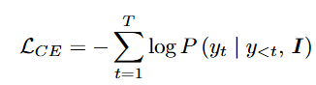
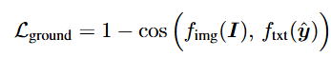
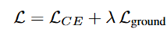

Methodology- Training
Cross-entropy loss
CLIP-based loss
Combined loss
$λ$ here is a warmup factor to first encourage the model to learn natural language before applying hallucination penalty.
Notes:
a provisional caption ˆy is decoded, and cosine similarity is computed between CLIP image and text embeddings, forming the grounding loss.
where fimg and ftxt denote the frozen CLIP encoders that map each modality into a shared embedding space, vector embeddings in order to assess the model performance

Slide 11
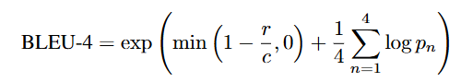
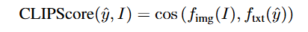
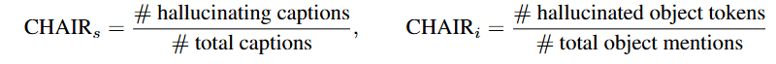
Experimental Results
Evaluation metrics:
BLEU-4: measures n-gram precision between a generated caption y’ and a set of human-written ground-truth references Y
CLIPscore assesses grounding
CHAIR measures hallucinations
Notes:
before getting into the results, we will discuss the evaluation metrics used.
where pn denotes the modified n-gram precision, c is the candidate caption length, and r is thereference length heuristic
this metric evaluates the performance of the model in learning natrual language., however, CLIP score here helps assessing grounding. which is cosine similarity between the embeddings.

Slide 12
Experimental Results
Greedy vs Beam Search decoding:
During caption generation, the model produces a probability distribution over the vocabulary at each step.
Greedy decoding selects the highest-probability word at every timestep
Beam search maintains multiple candidate sequences in parallel, expanding only the most promising hypotheses based on cumulative log-probability.
Notes:
This makes it fast and deterministic but prone to getting stuck in locally optimal word choices, leading to generic or repetitive captions.
This offers a more global search over the caption space and generally improves fluency and coherence. However, beam search is slower and can still favor common language patterns if visual grounding is weak.

Slide 13
Experimental Results
Baseline:
We adopt the paper Show, Attend, and Tell (SAT) as our baseline
Encoder: CNN based on Resnet and pretrained on ImageNet
Decoder: attention-based LSTM
Utilizes greedy decoding

Slide 14
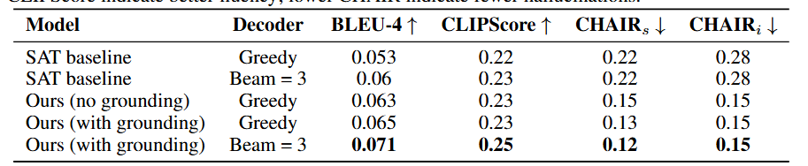
Experimental Results
Quantitative Results:
The proposed model shows an improvement over the baselines, however, due to the heavy computational complexity of the problem, training was done on a subset of the dataset for 5-10 epochs. Accessing more powerful resources and training on the full dataset for higher number of epochs would yield better numbers.

Slide 15
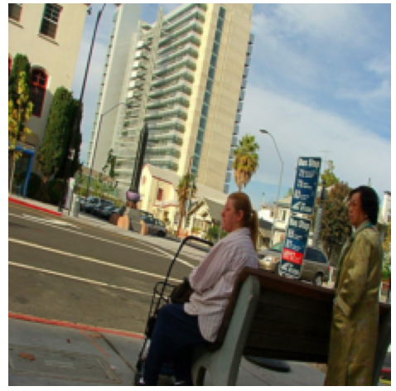
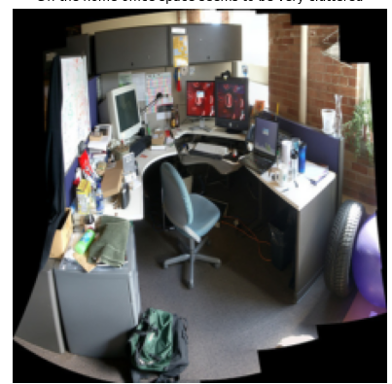
Experimental Results
Qualitative Results:
Baseline (beam=3): “A man sitting on a street with a city street”
Ours (beam=3): “A group of people waiting in a city street”
Ground Truth: “A woman sitting on a bench and a woman standing waiting for the bus”
Baseline (beam=3): “a kitchen with astove and a sink”
Ours (beam=3): “a computer desk with a monitor and a chair”
Ground Truth: “an office cubicle with four different types of computers”
Notes:
Hallucinates a man, loses the notion of two people, and is vague about the setting.
Ours (Transformer + CLIP grounding, beam=3): “A group of people waiting in a city street” → Correctly identifies multiple people and the waiting context, though still falls short
Here, The baseline misclassifies the entire scene category as a kitchen. Our grounded model correctly recovers the office semantics, greatly reducing hallucination.

Slide 16

Conclusion
Successes
PixelParlance successfully improved the semantic alignment between input images and generated text.
Limitations
Computational constraints restricted our training to a subset of the COCO dataset.
Our grounding mechanism relies heavily on a pre-trained CLIP model.
Our current loss function applies a scaler penalty based on a global sentence embeddings
Future Work
Explore fine-grained token-level contrastive losses or integrate constrained beam search
Notes:
By replacing traditional CNNencoders with a pre-trained Vision Transformer (ViT) and augmenting the training objective witha CLIP-guided consistency loss, we successfully improved the semantic alignment between inputimages and generated text. Our results on the MS COCO validation set indicate that while standardlikelihood-based training prioritizes fluency, often at the cost of accuracy, our grounded approachstrikes a better balance. The reduction in CHAIR metric scores confirms that our model is lessprone to fabricating non-existent objects, marking a step forward in building more reliable visiontechnologies.

